Slide 1
Infrastructure as TypeScript
Managing Cloud with Pulumi
Mikhail Shilkov

Slide 2

About me
Software developer
Cloud
Serverless
Functional Programming, F#
Microsoft Azure MVP
https://mikhail.io @MikhailShilkov

Slide 3

Sample App
URL Shortener

Slide 4
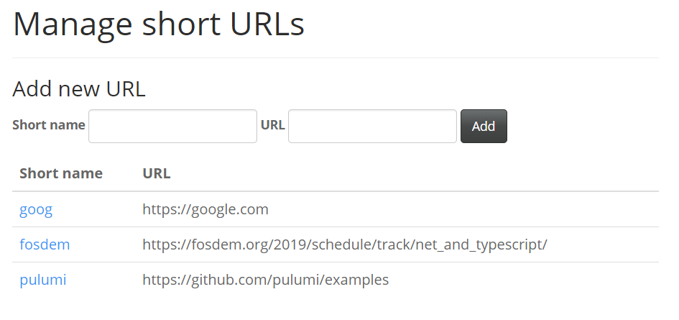
URL Shortener

Slide 5
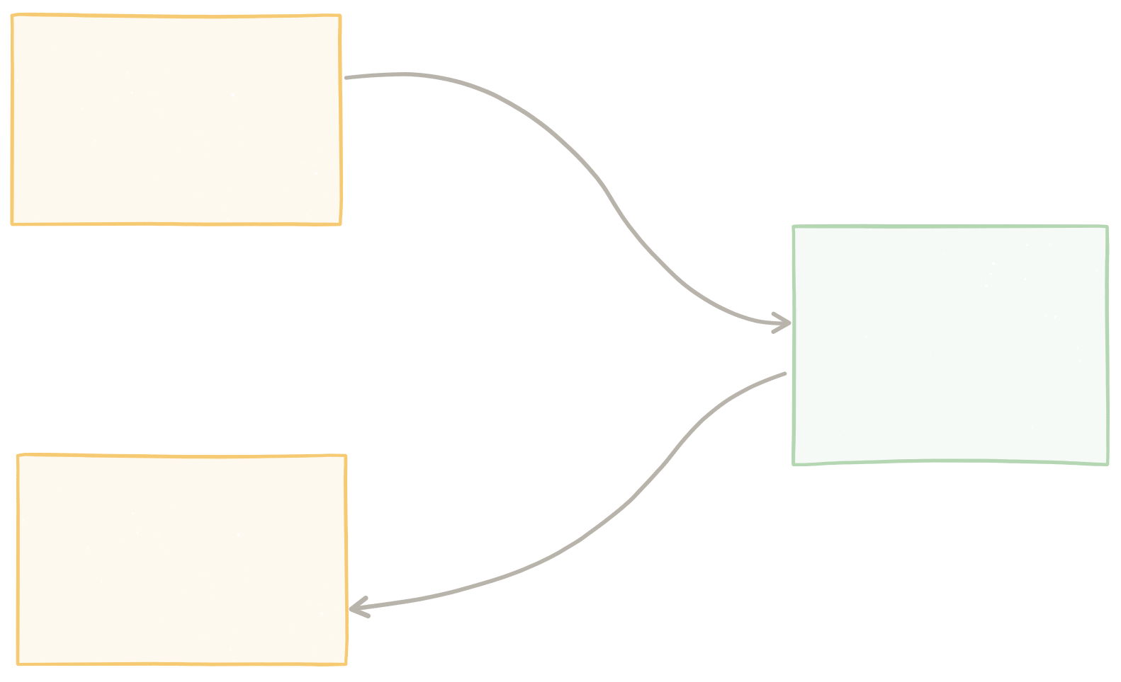


Serverless URL Shortener
AWS Lambda
“Add URL”
AWS DynamoDB Table “URLs”
AWS Lambda
“Open URL”

Slide 6
AWS Lambda code
const aws = require('aws-sdk');
const table = new aws.DynamoDB.DocumentClient();
exports.handler = async (event) => {
const name = event.path.substring(1); const params = { TableName: "urls", Key: { "name": name } };
const value = await table.get(params).promise(); const url = value && value.Item && value.Item.url;
return url
? { statusCode: 301, body: "", headers: { "Location": url } }
: { statusCode: 404, body: name + " not found" };
};

Slide 7
AWS Lambda code
const aws = require('aws-sdk');
const table = new aws.DynamoDB.DocumentClient();
exports.handler = async (event) => {
const name = event.path.substring(1); const params = { TableName: "urls", Key: { "name": name } };
const value = await table.get(params).promise(); const url = value && value.Item && value.Item.url;
return url
? { statusCode: 301, body: "", headers: { "Location": url } }
: { statusCode: 404, body: name + " not found" };
};

Slide 8
AWS Lambda code
const aws = require('aws-sdk');
const table = new aws.DynamoDB.DocumentClient();
exports.handler = async (event) => {
const name = event.path.substring(1); const params = { TableName: "urls", Key: { "name": name } };
const value = await table.get(params).promise(); const url = value && value.Item && value.Item.url;
return url
? { statusCode: 301, body: "", headers: { "Location": url } }
: { statusCode: 404, body: name + " not found" };
};

Slide 9
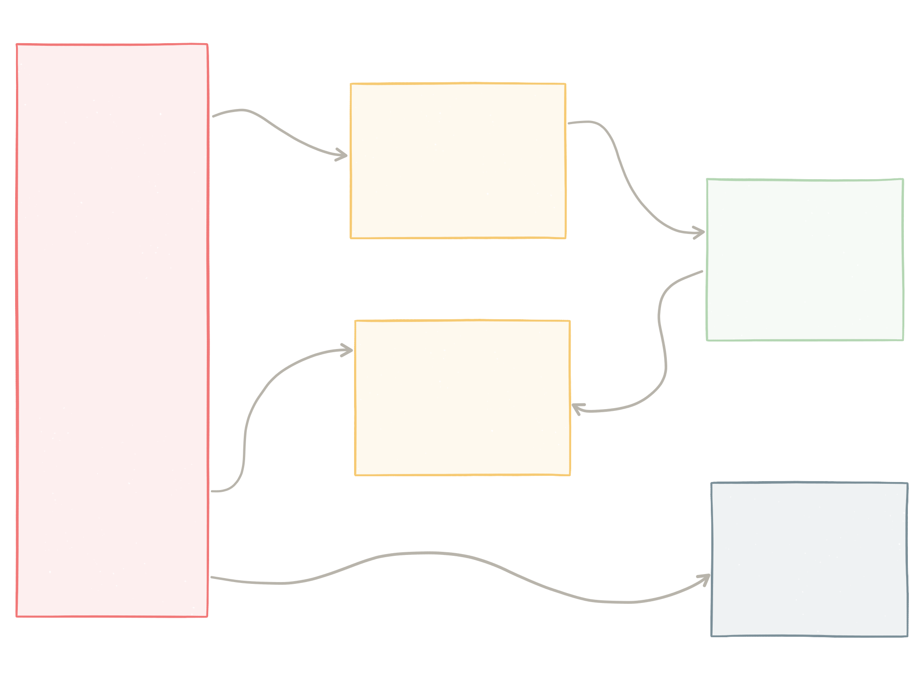




Diagram of the app with all resources
Lambda
“Add URL”
DynamoDB “URLs”
API Gateway
Lambda
“Open URL”
S3 Bucket
Static site

Slide 10





Diagram of the app with all resources
Stage Deployment REST endpoint
Permissions
Permissions Policy
Lambda
“Add URL”
DynamoDB “URLs”
API Gateway
Lambda
“Open URL”
Bucket Objects
S3 Bucket
Static site

Slide 11
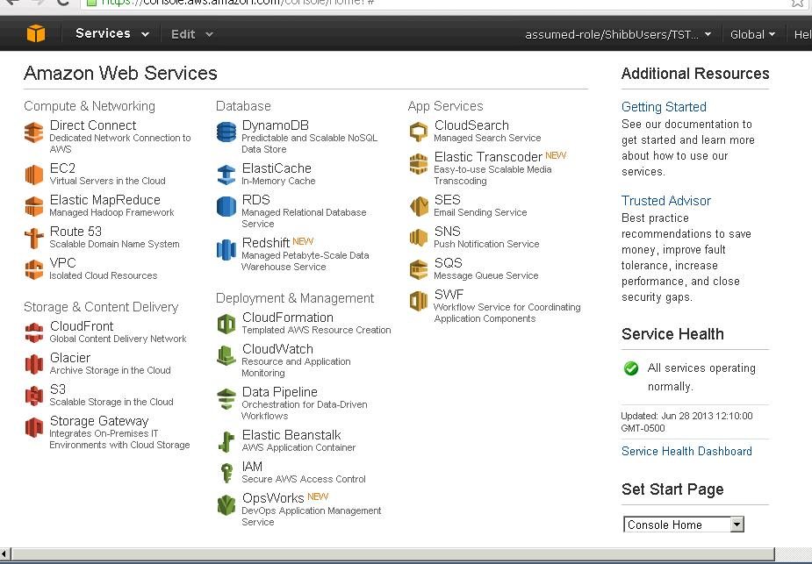




Options to deploy the infra
…

Slide 12
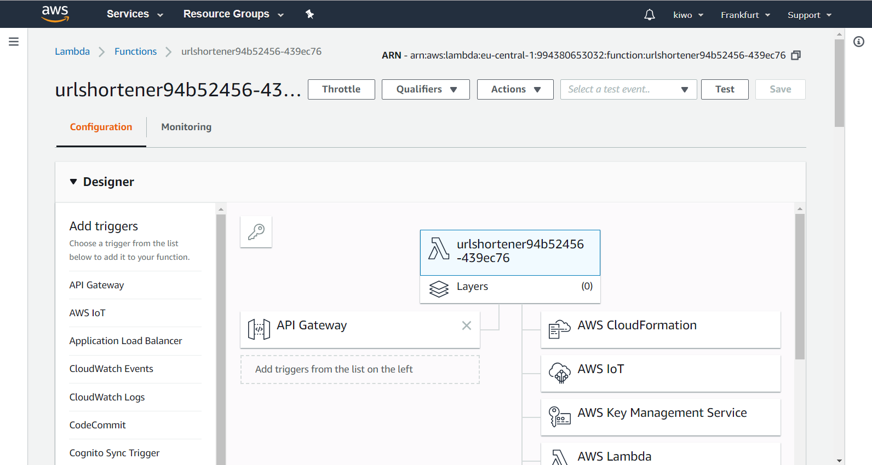
Options: AWS Web Console
Good for exploration Not reproducible
https://console.aws.amazon.com

Slide 13
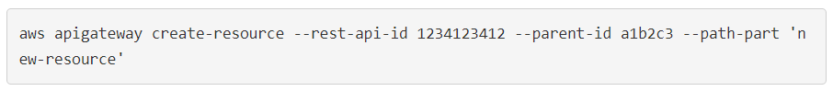
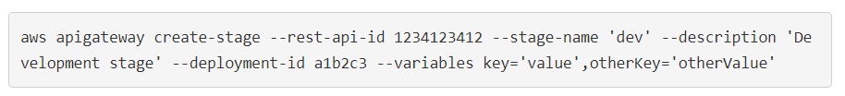
Options: AWS CLI
Scriptable
Imperative, “how to do” not “what to do”
https://docs.aws.amazon.com/cli/latest/reference/

Slide 14
Options: CloudFormation
Resources:
S3BucketForURLs:
Type: "AWS::S3::Bucket"
DeletionPolicy: Delete
Properties:
BucketName: !If [ "CreateNewBucket", "AWS …
WebsiteConfiguration:
IndexDocument: "index.html"
LifecycleConfiguration:
Rules:
-
Id: DisposeShortUrls
ExpirationInDays: !Ref URLExpiration
Prefix: "u"
Status: Enabled
Desired state configuration with YAML Verbose
https://aws.amazon.com/blogs/compute/ build-a-serverless-private-url-shortener/

Slide 15
Options: Terraform
resource "aws_lambda_function" "apply_security_headers" {
provider = "aws.cloudfront_acm"
filename = "lambda_functions/security_headers.zip"
function_name = "apply_security_headers"
role = "${aws_iam_role.short_url_lambda_iam.arn}"
handler = "lambda_function.handler"
source_code_hash = "${data.archive.security.base64}"
runtime = "nodejs8.10"
publish = true
tags = {
Project = "short_urls"
}
}
Proprietary format
Multi-cloud
https://github.com/jamesridgway/aws-lambda-short-url

Slide 16
Options: Serverless Framework
functions:
store:
handler: api/store.handle
events:
- http:
path: /
method: post
cors: true
resources:
Resources:
ServerlesslyRedirectS3Bucket:
Type: AWS::S3::Bucket
Properties:
BucketName: ${file(config.json):BUCKET}
AccessControl: PublicRead
WebsiteConfiguration:
YAML
Succinct Narrow scope
Multi-cloud
https://github.com/danielireson/serverless-url-shortener

Slide 17
Desired properties of infra
Scriptable
Applicable for any cloud service
Reproducible
Multi-cloud (+ hybrid)
Desired state configuration
Language?

Slide 18
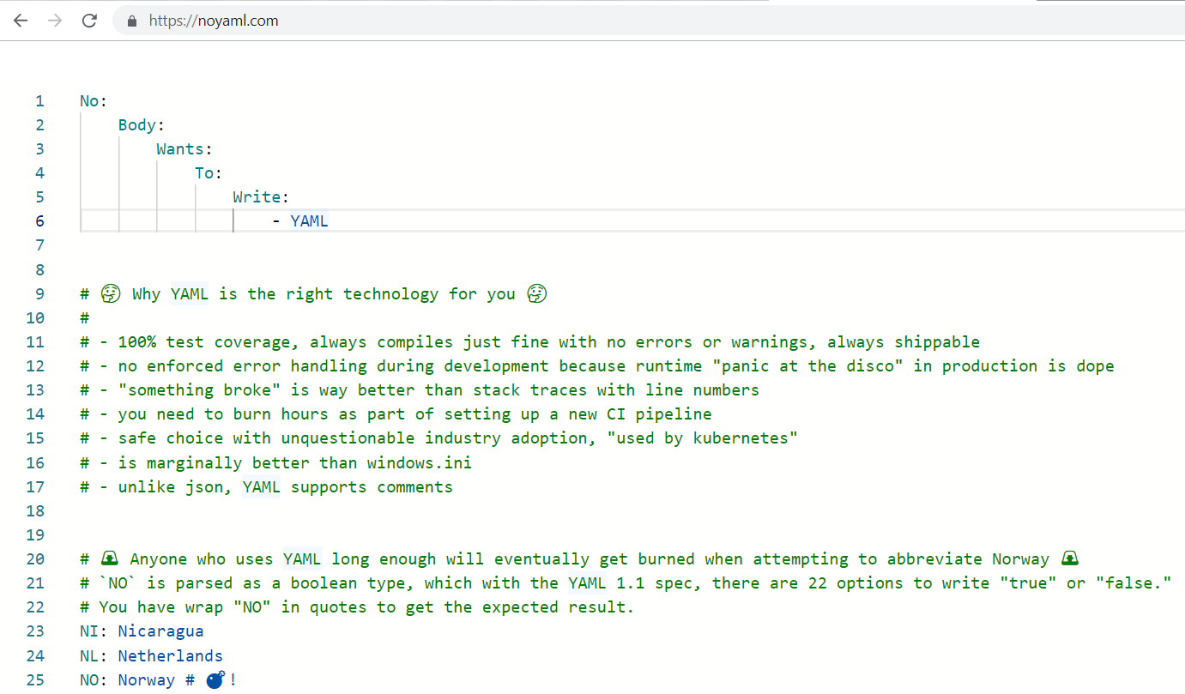
https://noyaml.com

Slide 19

Scriptable
Applicable for any cloud service
Reproducible
Multi-cloud (+ hybrid)
Desired state configuration
YAML TypeScript (or Python, Go, …)

Slide 20

Pulumi

Slide 21
Pulumi CLI Stacks State
Demo

Slide 22
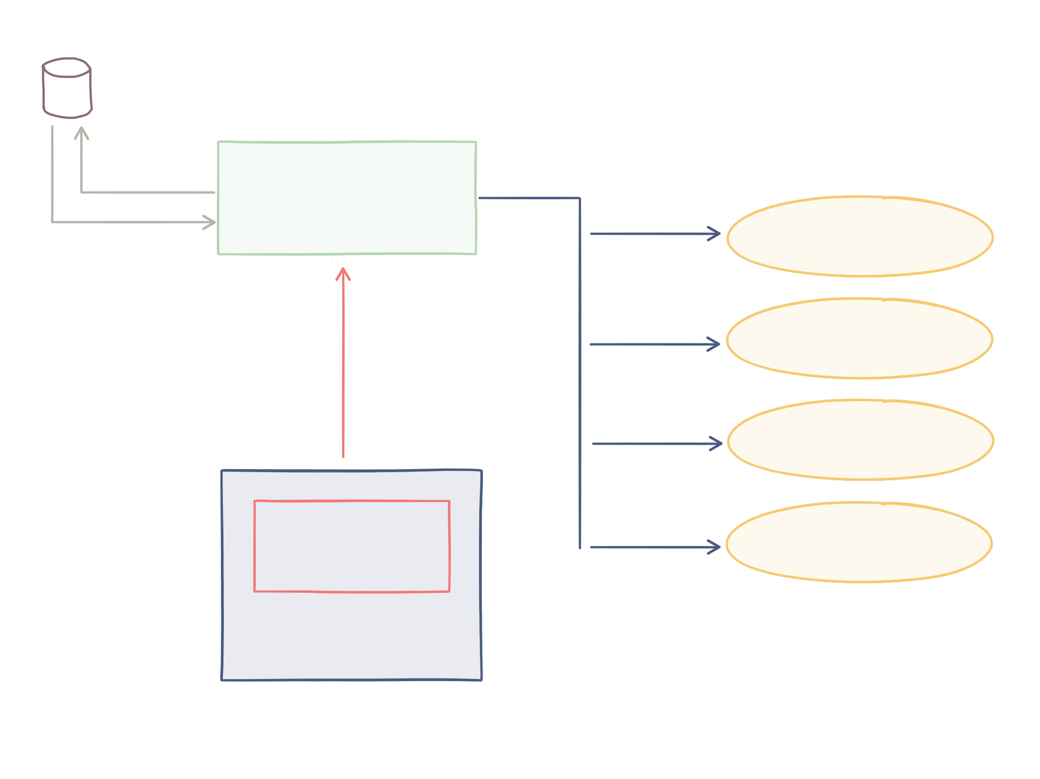
How Pulumi works
Last deployed state
Create, update, delete
CLI and Engine
AWS
Azure
new Resource()
GCP
index.ts
Kubernetes
Language host

Slide 23
Types IntelliSense Compiler errors Language Constructs Reusable Components Component Library Blend of Infra and Code Pulumi Cloud
Demo

Slide 24

Pulumi Layers
Pulumi Cloud
Pulumi AWS Cloud
Pulumi Resources
Resource Provider
Cloud API

Slide 25

Conclusions

Slide 26



USE INFRASTRUCTURE- AS-CODE
Making Cloud Apps?

Slide 27




Real Programming Language!
What Kind of “Code”?

Slide 28
Useful Links
Slides and demos:
https://github.com/MikhailShilkov/fosdem2019
Pulumi: https://pulumi.io/ Usage examples: https://github.com/pulumi/examples

Slide 29
@MikhailShilkov
https://mikhail.io

